Slide 1
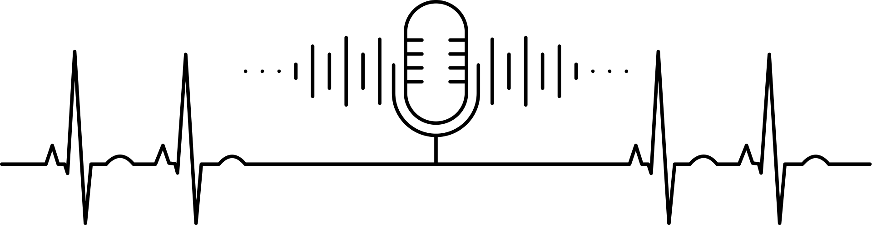
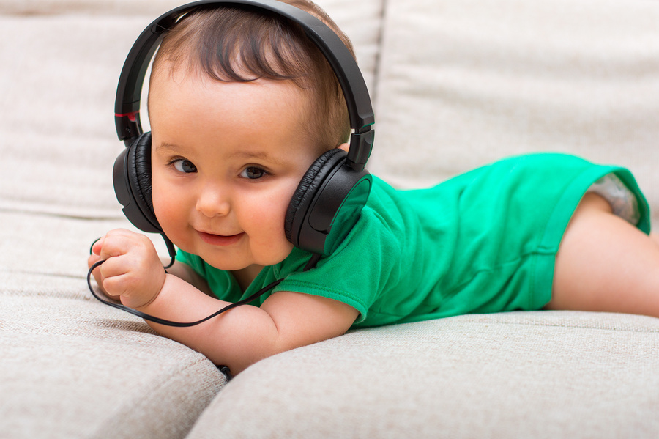
Listen for Life
The Hannah Center Presents Our Annual
Hannah-Thon
streaming on spirit95.com
Friday, April 11th
6am-6pm
ON
SPIRIT 95.1

