Slide 1

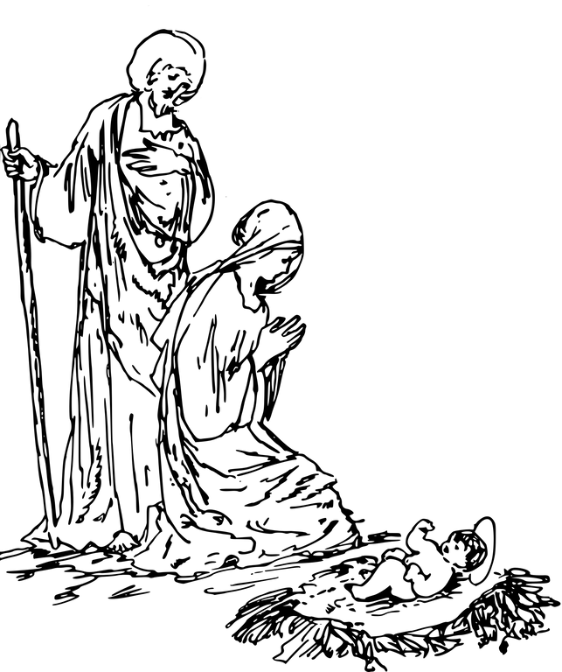
Hannah
GALA
Thursday
12
December
6:00 PM
SWITCHYARD PARK PAVILION
1601 S ROGERS STREET
hannahcenter.org/gala
Notes:
S

